Slide 1

Heart Disease Prediction System Using Logistic Regression
A Machine Learning based web application that predicts the risk of heart disease using user-provided medical inputs.
Project By:
JASMINE SULTANA
Guide Name:
HIMANSHU SOUDA

Slide 2
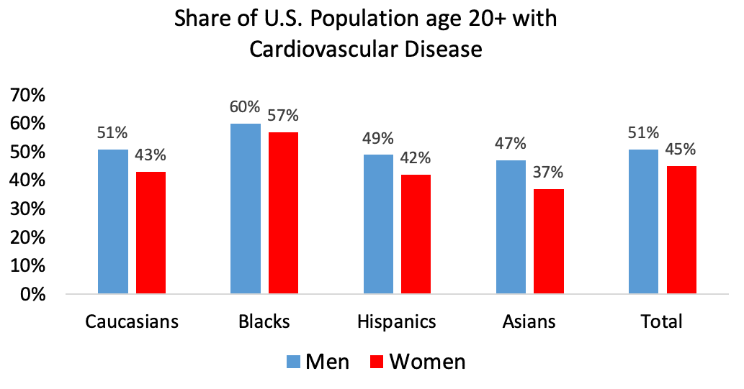
agenda
Introduction to Heart Disease Prediction Why early detection matters and how data helps.
Dataset & Model Overview of features used and Logistic Regression for prediction.
How the System Works Data input → Model prediction → Result interpretation.
Web App Demonstration Live prediction through a Streamlit interface.
Results & Limitations Accuracy, output examples, and current constraints.
Future Scope & Improvements Better models, more features, and medical integration.
Conclusion Summary of benefits and project learning outcomes.

Slide 3
Introduction
Heart disease is one of the leading causes of death worldwide. Due to lifestyle habits, stress, and late diagnosis, many people realize the risk only when the condition becomes serious. Early awareness can prevent major complications and save lives.
Machine Learning helps by analyzing medical parameters and predicting possible risks at an early stage. By studying patterns in blood pressure, cholesterol, sugar levels, chest pain, and heart rate, ML can give an early warning and encourage timely medical care.

Slide 4
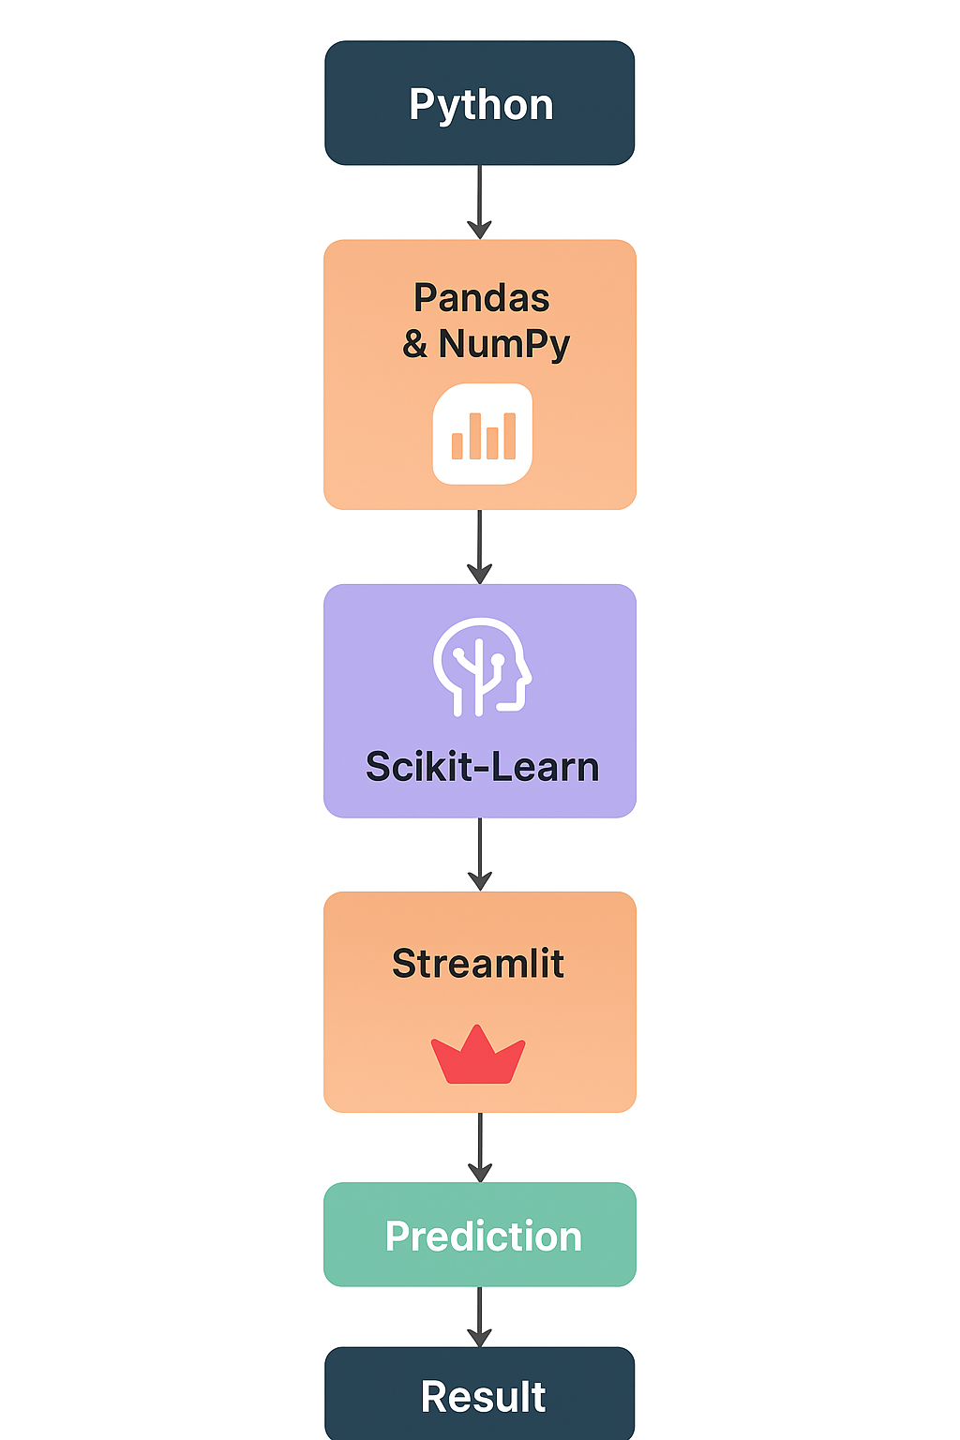
Tech Stack
Python
Pandas & NumPy – Data handling
Scikit-Learn – Logistic Regression
Streamlit – Frontend Web App
Matplotlib / Seaborn– Visualization

Slide 5
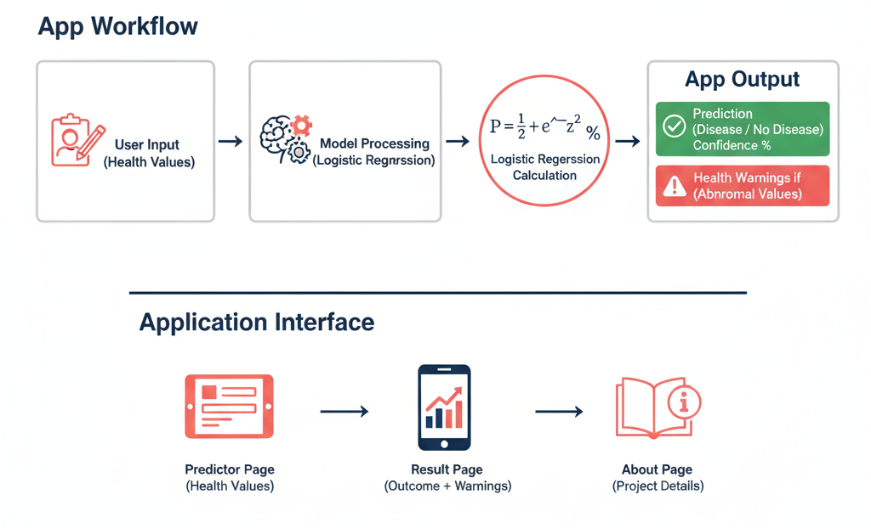
How the Application Works
User enters their medical details
Model processes inputs
Logistic Regression calculates
disease probability
App shows:
Prediction (Disease / No Disease)
Confidence %
Health warnings if any value is
abnormal
Application Interface
Predictor Page – user inputs health values
Result Page – model outcome + warnings
About Page – project details

Slide 6
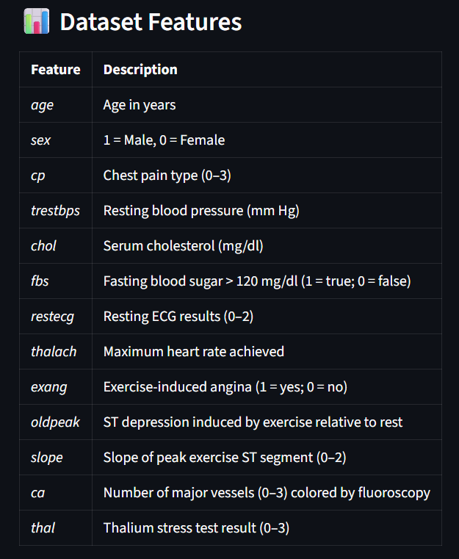
Dataset & Features
Common features used:
Chest pain type (cp)
Resting blood pressure (trestbps)
Cholesterol level (chol)
Fasting blood sugar (fbs)
Resting ECG (restecg)
Maximum heart rate (thalach)
Exercise-induced angina (exang)
ST depression (oldpeak)
Slope, CA, Thal

Slide 7
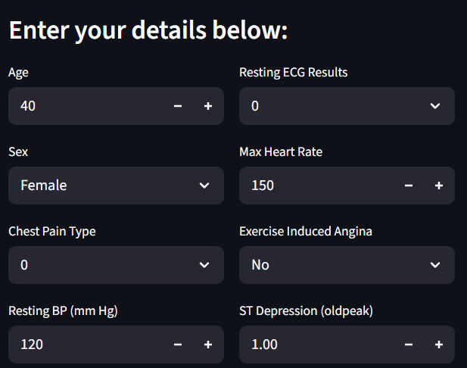
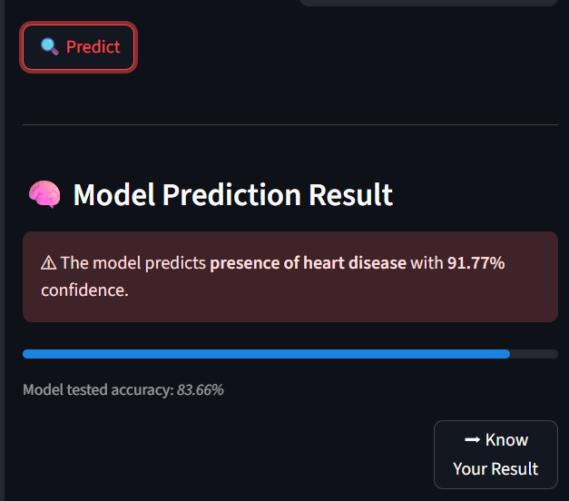
#1 Predictor (home_page)
 | Users start by entering their medical details such as age, gender, cholesterol level, blood pressure, chest pain type, ECG results, maximum heart rate and more.
After filling the form, they click Predict, and the trained Logistic Regression model analyzes the inputs and instantly shows whether there is a risk of heart disease along with the confidence score.

Slide 8
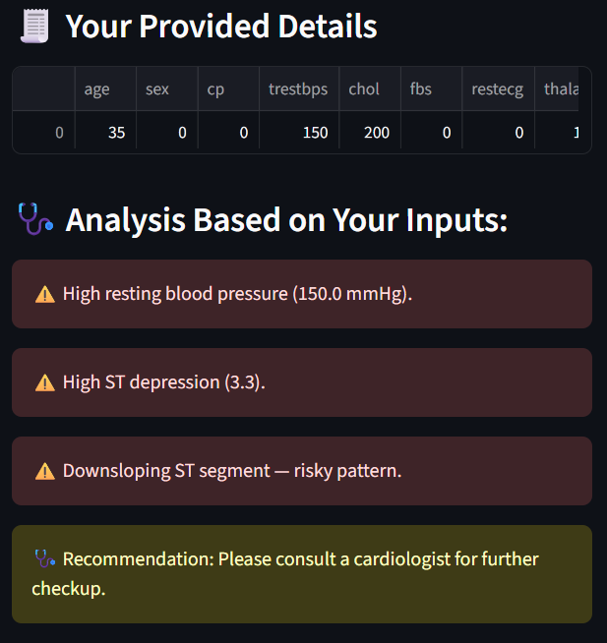
#2 Result
Once the model predicts the outcome, the result page shows two things:
i. A summary table of the input values entered by the user
ii. A parameter-wise risk analysis derived from the model
The system checks each feature and flags potential symptoms like high resting BP, elevated ST depression, or downsloping ST segments, accordingly user input.
At the end, a recommendation message is displayed, guiding the user toward medical consultation if risk is detected.

Slide 9
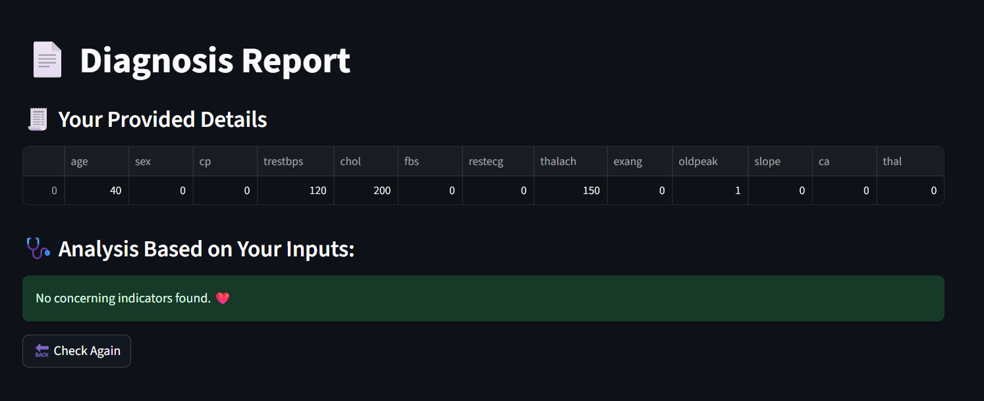
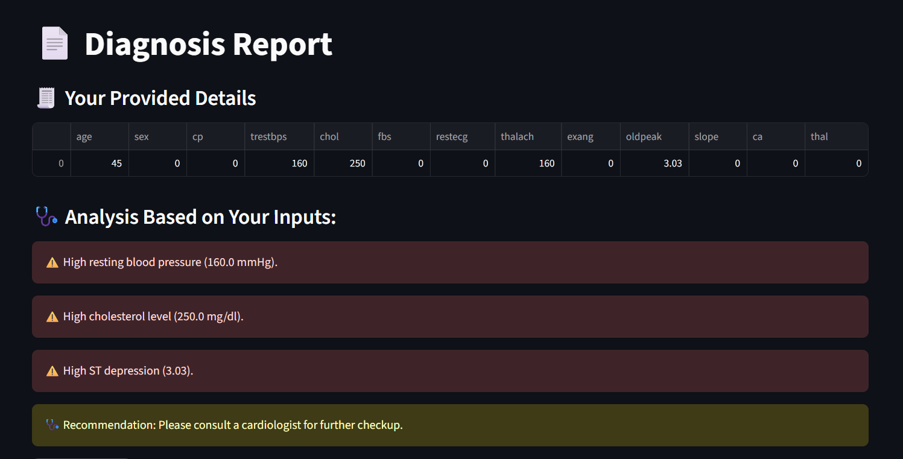
Result & Output
 | Prediction: NO When a user enters their medical details, the system analyzes the values and produces one of two possible results. If the parameters such as cholesterol, blood pressure, and heart rate fall within a healthy range, the model predicts “No risk of heart disease.”
Prediction: YES If the input values cross certain medical risk limits, the model predicts “Possibility of heart disease.” The output then shows a caution message and advises the user to seek medical consultation for further evaluation..

Slide 10
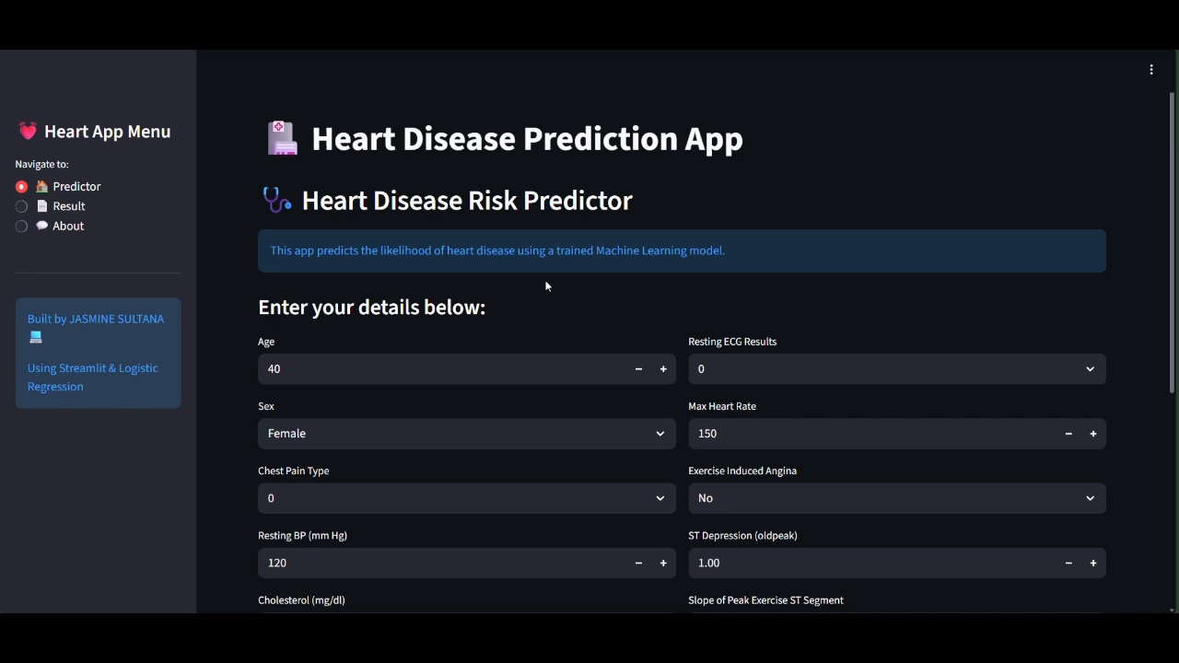
App-Demonstration
Streamlit-powered ML web application delivering real-time heart disease risk prediction from medical inputs.

Slide 11
Applications
I. Early screening tool for heart risk awareness Helps users understand their risk level before symptoms become serious, promoting preventive health care.
II. Supports doctors with additional insights Acts as a quick, data-based indicator to assist medical professionals in decision-making.
III. Useful for health camps and remote areas Works even where advanced diagnostic machines are not available, making it suitable for rural or low-resource regions.
IV. Educational tool for learning ML-based medical prediction Students and researchers can study how machine learning models analyze medical parameters and classify heart risk.

Slide 12
Problem faced & solutions
Problem:
The dataset had missing, messy, and uneven values
Solution:
Performed data cleaning, handled missing values, encoded categorical columns, and normalized features for better model accuracy.
Problem:
UI layout looked cluttered, and incorrect user input caused errors
Solution:
Used Streamlit layout, validation checks, and sidebar navigation to make a clean, error-free interface.

Slide 13

Future scope
Future Scope
Use of deep learning or ensemble models for better accuracy
Add more medical parameters (e.g., ECG, blood reports)
Convert into full mobile/web health assistant
Connect with hospital databases for real clinical use
Provide lifestyle suggestions based on
user results
Deploy on cloud to allow access
from anywhere

